Slide 1
HEALTH AND DEMOGRAPHICS: DEATH RATES FOR FLU GROUP 16 – DEATH RATES
Ravi Kiran Nallamothu
Sandeep Kumar Balachandran Nair
Satyasandeep Pulletikurthi
Vinay Chowdary Mandava

Slide 2


INDEX
Introduction
Background Research
Variables
Hypothesis
Data Description
Data Wrangling
Feature Engineering
EDA
Methodology & Analysis
Discussion

Slide 3

INTRODUCTION
Global Health Impact: Influenza significantly threatens public health globally, with severe implications during epidemics and pandemics.
Healthcare System Indicator: Flu-related death rates critically reflect the effectiveness of global health systems and inform policy decisions.
Public Health Strategy Guide: Mortality data guides essential health strategies, influencing resource allocation and preventive measures.
Global Health Governance: Analyzing flu mortality is key to international health collaboration and effective response planning.

Slide 4

BACKGROUND RESEARCH
Impact of Influenza: Essential to study due
to significant health and economic impacts on
public health and businesses.
Influenza Survivor Research: Highlights
increased healthcare costs, identifies risk factors,
and analyzes economic burdens on businesses and
healthcare systems.
Independent Variables in Our Study: Focuses
on flu death rates with socioeconomic status, and
demographic factors affecting influenza outcomes in
urban and rural areas.

Slide 5

RESEARCH QUESTIONS
Main Research Question:
Influence of socioeconomic, demographic, and geographic
variables on pneumonia and influenza death rates in the
U.S.
Socioeconomic Factors:
Sub-Question: Effect of poverty on flu mortality rates.
Hypotheses:
H0: Poverty levels do not significantly affect death rates.
H1: Significant relationship between poverty and death rates.

Slide 6
RESEARCH QUESTIONS
Demographic & Geographic Factors
Demographic Variables:
Sub-Question: Impact of population density, segregation, and race/sex disparities.
Hypotheses:
H0: No significant impact from these variables.
H1: Significant influence of demographic factors.
Geographic Factors:
Sub-Question: Correlation of regional location and urban/rural status.
Hypotheses:
H0: Location and urban/rural status do not significantly influence rates.
H1: Significant impact of geographic factors.

Slide 7
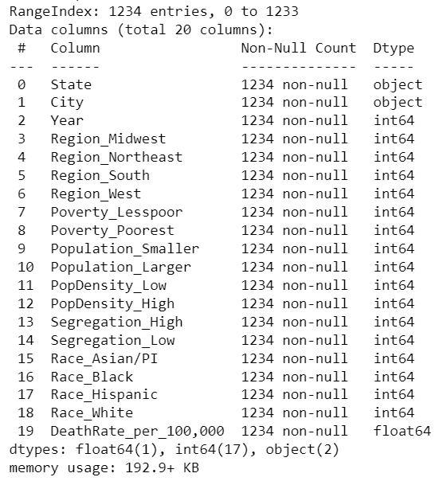
Methodology Dataset:
this dataset provides information about various socio-economic and demographic factors across different cities and states, including regions, poverty levels, population sizes, population density, segregation levels, racial demographics, and death rates over multiple years.
The dataset contains 1234 rows (entries) and 20 columns

Slide 8
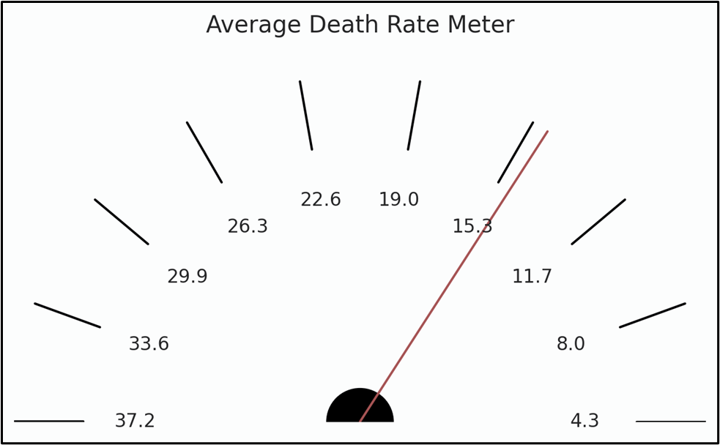
METHODOLOGY
Data Source and Composition:
Utilizing the 'BigCitiesHealth' database.
Data spans 2010-2021, focusing on health, demographic, and socioeconomic variables.
Dependent Variable:
Pneumonia or Influenza Death Rate
Independent Variables:
City and State
Population Density
Poverty
Race and Sex Labels
Population Segregation
Notes:
Nabeel Raheem

Slide 9
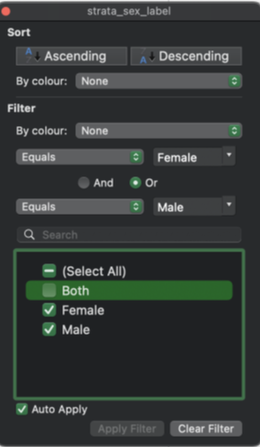
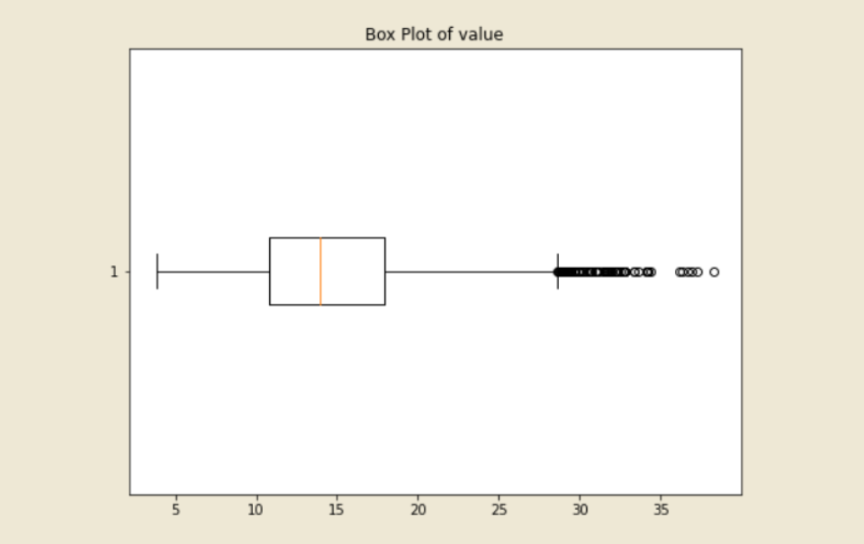
DATA QUALITY
Data Cleaning:
Deleted irrelevant columns with redundant or missing data.
Removed columns with negligible information or overlapping data.
Kept 12 unusual observations for comprehensive analysis.
Focused dataset by filtering race and gender categories.
Removed 'Gender' and aggregated 'Race Label' categories.
Data Transformation:
Ensured no duplicates or missing data.
Identified outliers using box plots but retained them for
comprehensive analysis.

Slide 10
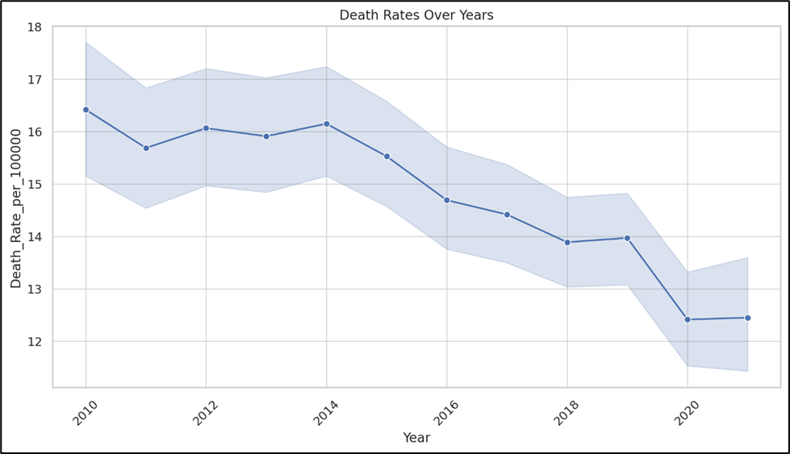
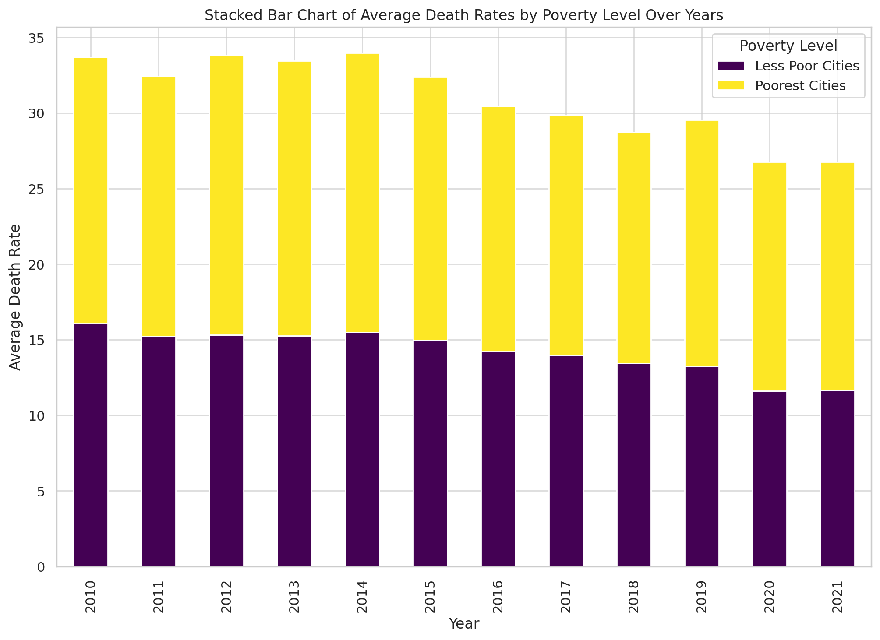
DATA VISUALIZATION
Temporal Trends (2010-2020)
Overall declining trend in death rates.
Confidence interval widens, suggesting increased variability.
Indicates a need for further investigation.
Poverty Level Impact
"Poorest Cities" consistently contribute more to death rates.
Highlights persistent disparities over 2010-2021.

Slide 11
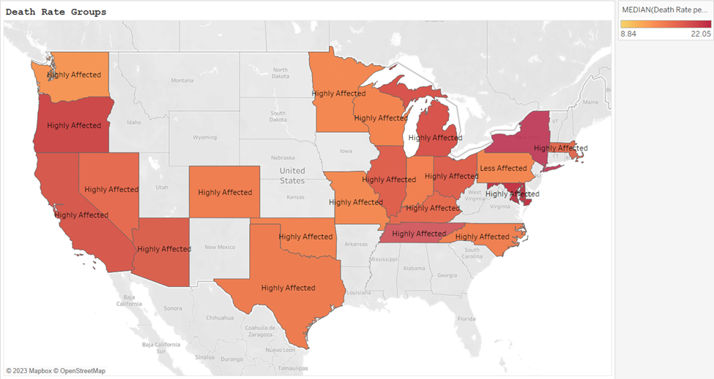
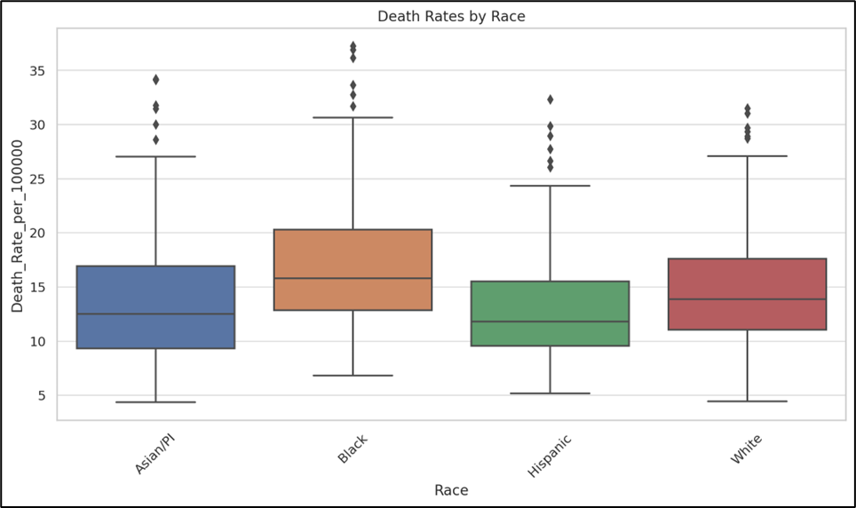
DATA VISUALIZATION
Visualizing Death Rates Across States & Cities
California and New York show higher rates.
NY, MI, and PA exhibit higher death rates.
TX and CA show lower rates.
Racial Disparities
'Black' category shows high variance and outliers.
'Asian/PI' and 'White' categories have lower median rates.

Slide 12
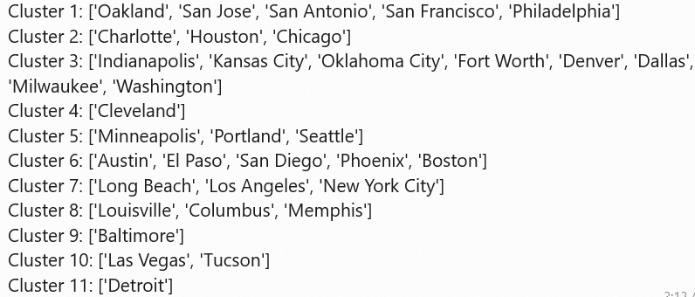
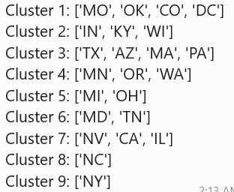
Feature Engineering
Grouping – Hierarchical Clustering:
After Hierarchical clustering the dataset size is 1234 rows and 49 columns
State:
City:

Slide 13
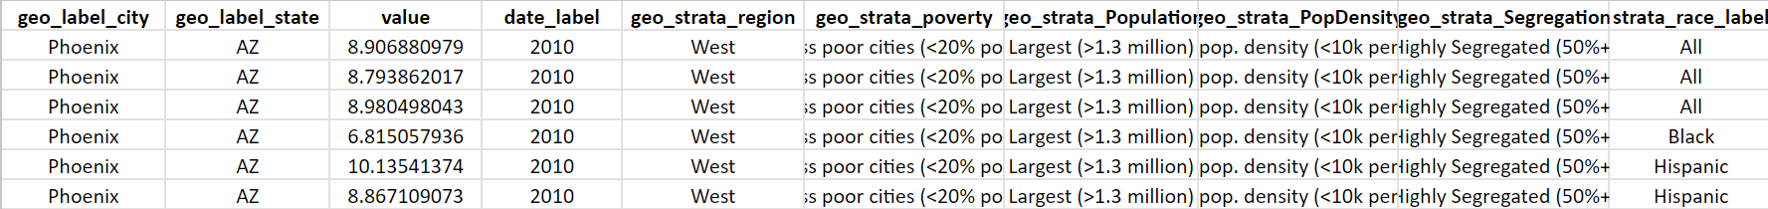
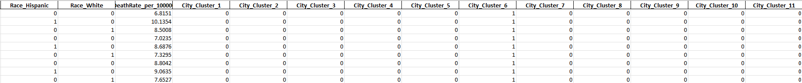
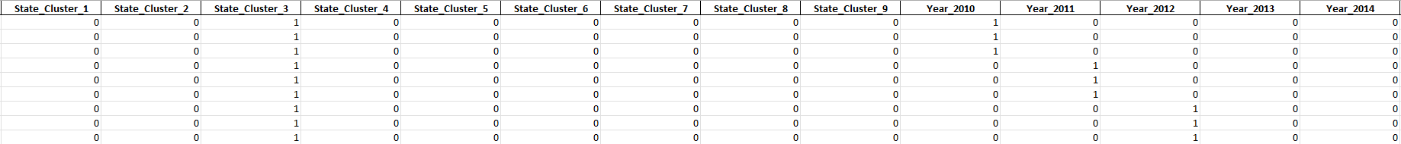
Feature Engineering
One Hot Encoding:

Slide 14
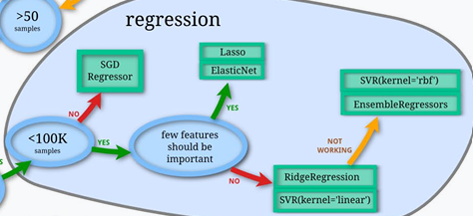
Machine learning model:

Slide 15
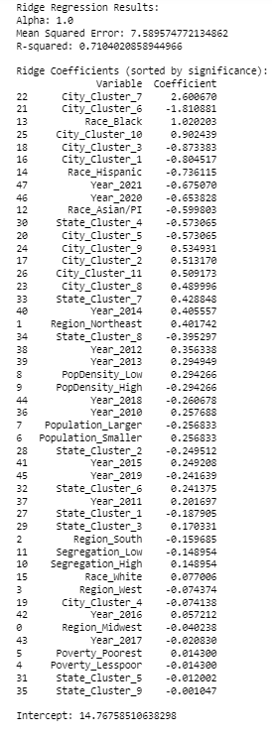
Statistical analysis
Ridge regression:
Dependent Variable: ‘DeathRate_per_100,000’ Mortality rate per 100,000 people.
Mean Squared Error (MSE): 7.589574772134862
R-squared: 0.7104020858944966, The R-squared value indicates that the model explains approximately 71% of the variance in the dependent variable.
Most Significant Positive Variables: City_Cluster_7, Race_Black, City_Cluster_10
Most Significant Negative Variables: City_Cluster_6, City_Cluster_3, City_Cluster_1

Slide 16
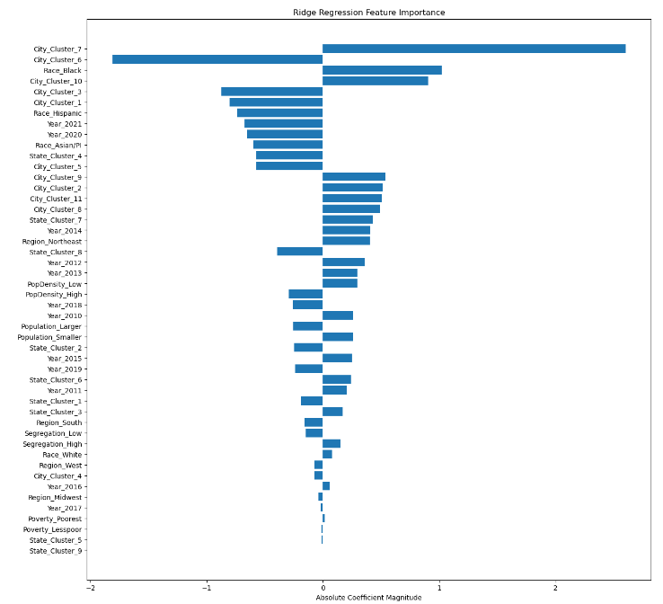
Ridge regression feature importance:
Here we can see how the variables having the significant relationship with dependent variable

Slide 17
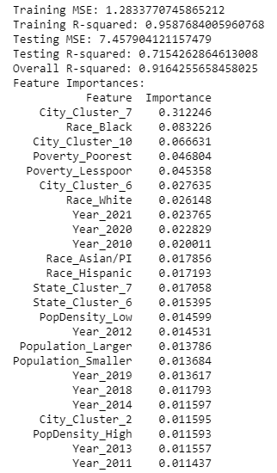
Random forest Regression:
The model explains approximately 92% of the variance in the dependent variable.
Training MSE: 1.2833770745865212
Training R-squared: 0.9587684005960768
Testing MSE: 7.457904121157479
Testing R-squared: 0.7154262864613008
Overall R-squared: 0.9164255658458025
The model performs well on both training and testing datasets, as evidenced by the high R-squared values. However, there is a noticeable drop in R-squared from training to testing, suggesting potential overfitting.

Slide 18
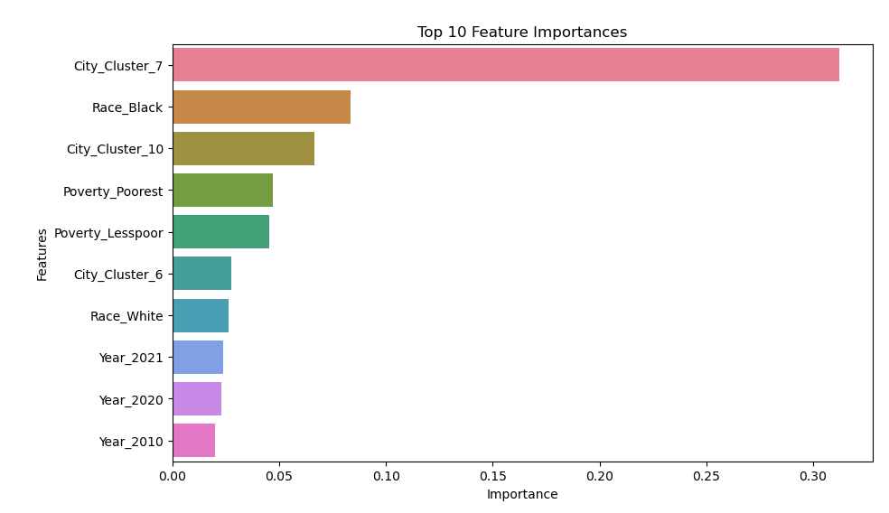
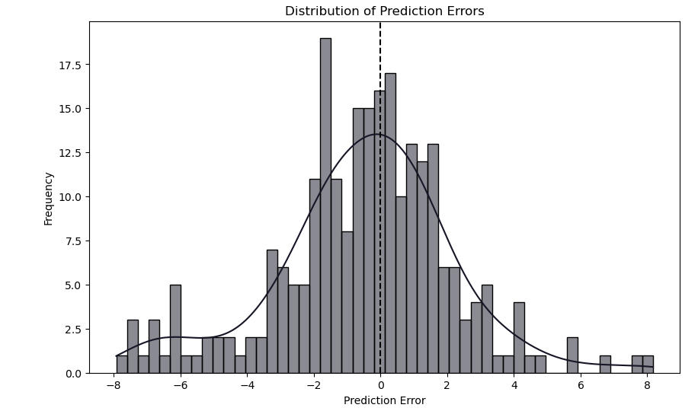
Distribution of prediction Errors:
FEATURE IMPORTANCE:

Slide 19
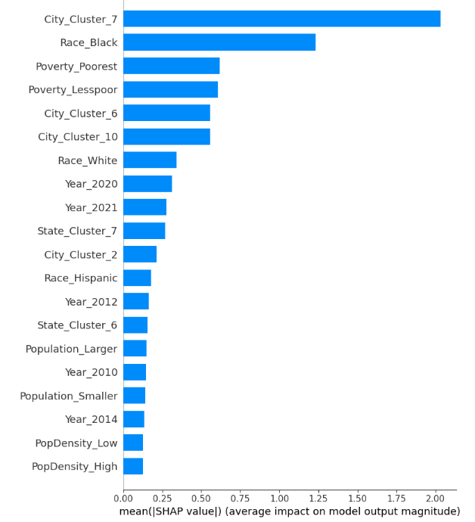
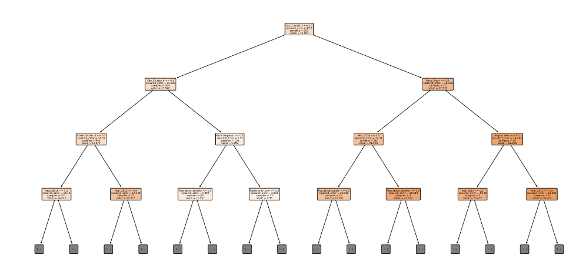
Decision Tree: SHAP Analysis:

Slide 20

FINDINGS

Slide 21
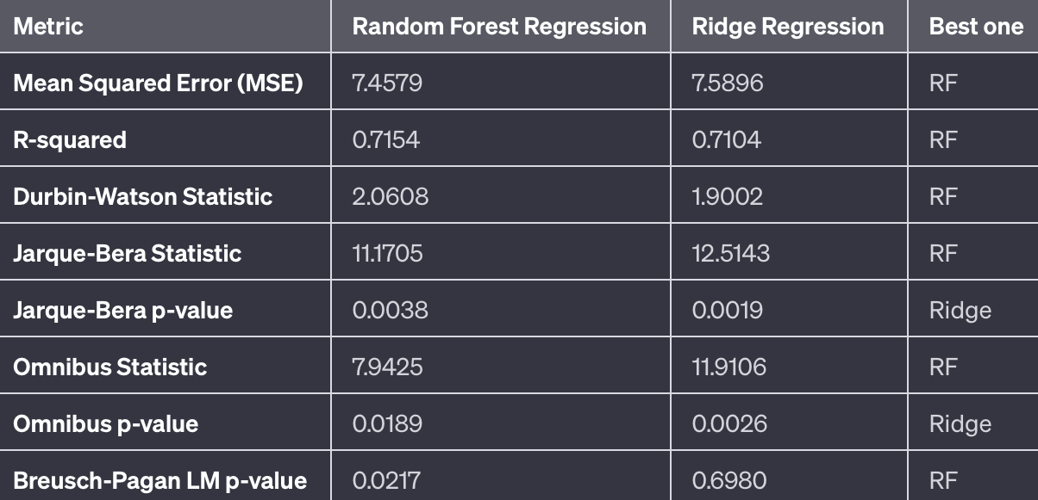
MODEL SIGNIFICANCE
Comparing Both Models.

Slide 22
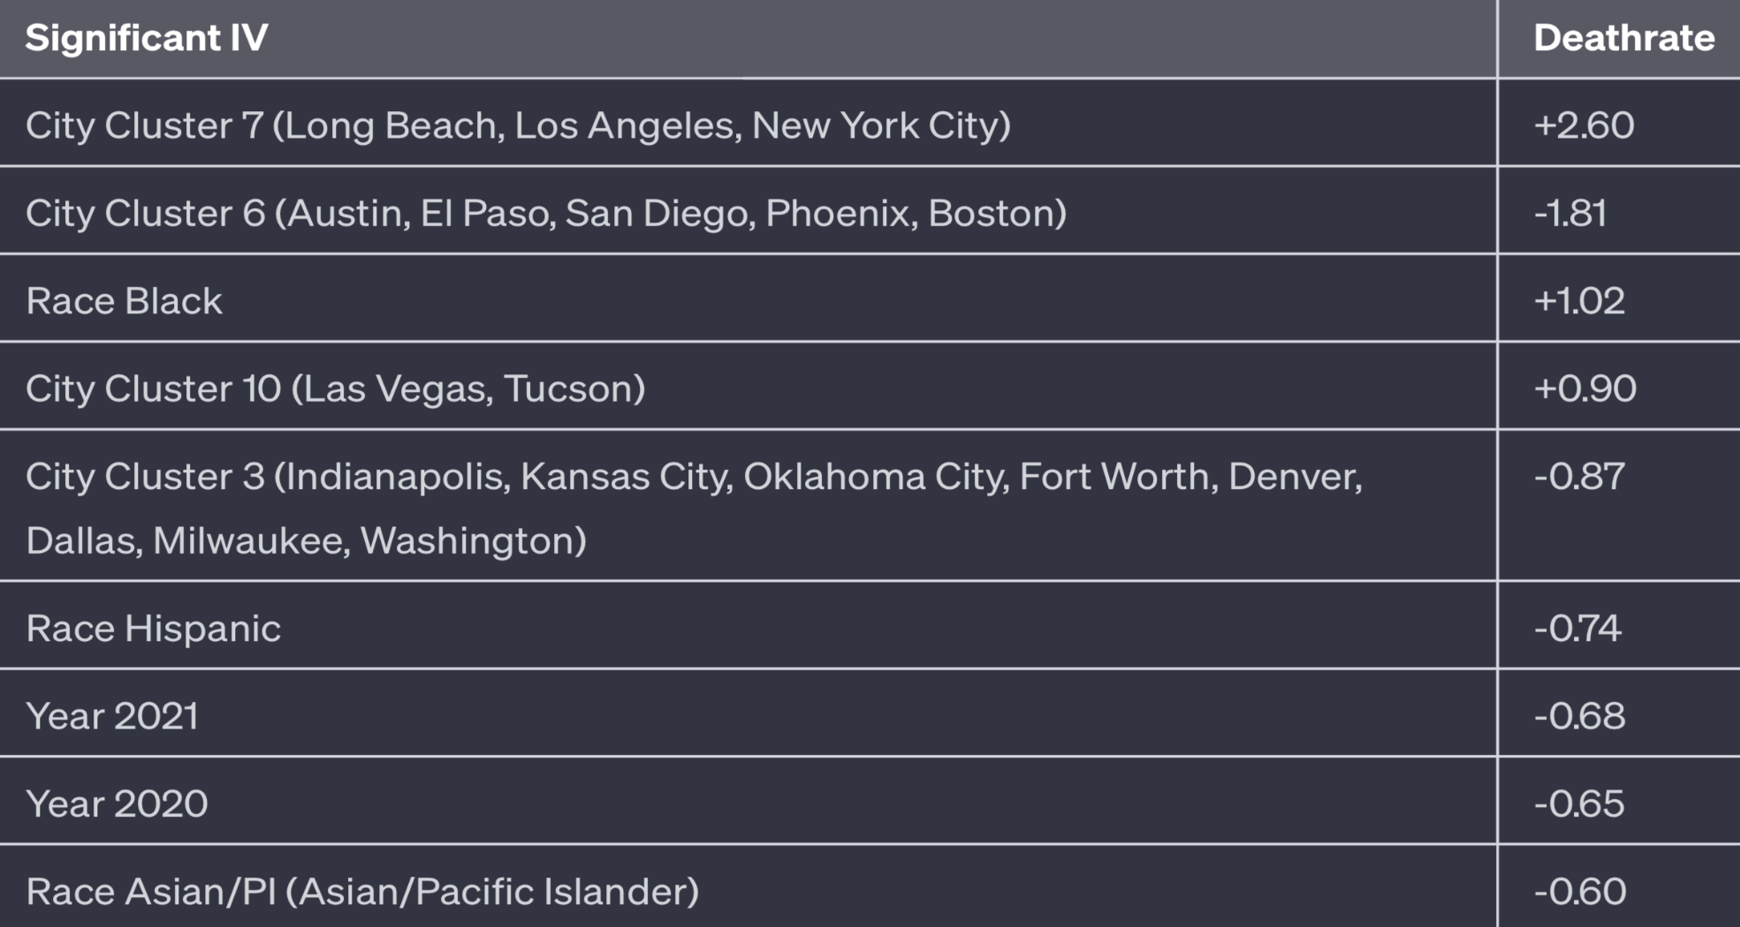
MODEL INTERPRETATION
Significant IV’s and Their Relationship with DV

Slide 23
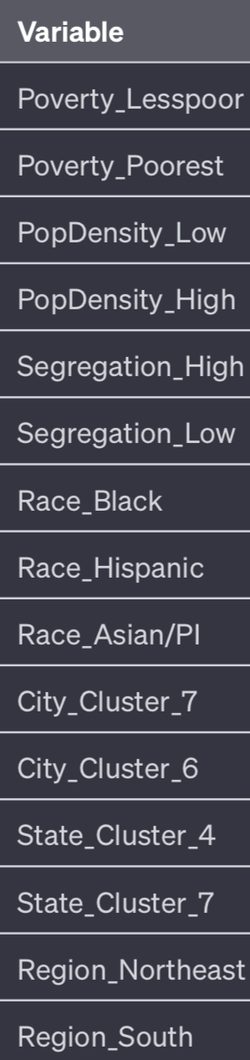
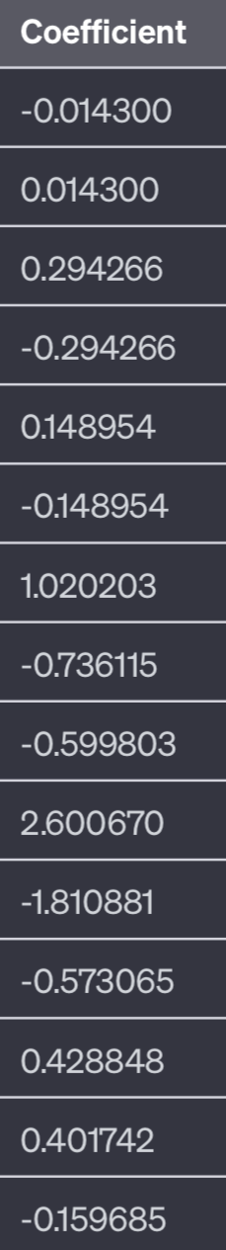
Checking Hypothesis.
Socioeconomic Factors:
Accept H0: No strong evidence of a significant relationship between poverty levels and death rates.
Reason: The coefficients for poverty-related variables are close to zero and not statistically significant.
Demographic Factors:
Reject H0: Demographic factors, including population density, segregation levels, and race/ethnicity, significantly influence death rates.
Reason: These demographic variables have non-zero coefficients and are statistically significant.
Geographic Factors:
Reject H0: Geographic factors, such as regional location and urban/rural status, significantly affect death rates.
Reason: Geographic variables have non-zero coefficients and are statistically significant.

Slide 24
RECOMMENDATIONS
Limitations:
Simplified Variables: Broad categorizations may oversimplify complex realities.
Data Constraints: Lack of continuous data limits analysis depth.
Model Interpretation: Categorical variables make interpreting impacts challenging.
Limited Generalizability: Findings may not apply to different contexts.
Statistical Considerations: Concerns about residuals and autocorrelation.

Slide 25
RECOMMENDATIONS
Future Scope:
Enhanced Data Detail: Use more detailed, continuous data.
Diverse Models: Explore different statistical models.
Wider Variables: Include factors like healthcare access.
Policy Impact: Assess the impact of interventions.

Slide 26
Conclusion:
Ridge Regression reveals socio-demographic associations with mortality rates.
Valuable results but acknowledge data and model limitations.
Emphasize the need for detailed data and diverse analysis methods.
Inform public health policies and strategies.
Collaboration with domain experts enhances real-world applicability.
Identifies factors for targeted interventions and supports healthcare planning.

Slide 27
References:
▪ https://ourworldindata.org/influenza-deaths
▪ https://www.sciencedirect.com/science/article/abs/pii/S0264410X21015619?via%3Dihu
b
▪ https://journals.plos.org/plosone/article?id=10.1371/journal.pone.0283475
▪ Association of Asthma With Treatments and Outcomes in Children With Critical Influenza - ScienceDirect
▪ Disease Burden of Flu | CDC
▪ https://jogh.org/documents/issue201902/jogh-09-020421.pdf
▪ https://www.ncbi.nlm.nih.gov/pmc/articles/PMC5818346/
▪ https://academic.oup.com/cid/article/54/10/1427/352114
▪ https://read.dukeupress.edu/demography/article/56/5/1723/168053/Determinants-of
Influenza-Mortality-Trends-Age

Slide 28
THANK YOU

